Slide 1

MICROSOFT POWEPOINT
ASSIGNMENT

Slide 2

TOPICS
NAVIGATION
4
CHARTS
3
2
THINGS TO DO
1
SAVING A TEMPLATE
Notes:
Notes to presenter:
What steps will you be taking as a result of this learning experience?
Did you learn from any failed experiences? How will you do things differently?
What advice will you give to others so they can learn from your experiences?
How can you share what you learned with a real-world audience?
Some examples of next steps might be:
After delivering my first persuasive presentation, I am thinking about joining the debate team.
After making my first film, I’m considering entering it in our school film festival or local film festival.
After connecting with this career expert, I’d like to do some research on that career field because it sounds interesting to me.
This SmartArt allows you add images and text to help outline your process. If a picture is worth a thousand words, then pictures and words should help you communicate this reflection on learning perfectly! You can always click on Insert>SmartArt to change this graphic or select the graphic and click on the Design contextual menu to change the colors.
Feel free to use more than one slide to share your next steps. It also helps to add some video content to explain your message.

Slide 3


What did I learn?
Introduction
importance
working
saving
Notes:
Notes to presenter:
Description of what you learned in your own words on one side.
Include information about the topic
Details about the topic will also be helpful here.
Tell the story of your learning experience. Just like a story there should always be a beginning, middle and an end.
On the other side, you can add a graphic that provides evidence of what you learned.
Feel free to use more than one slide to reflect upon your process. It also helps to add some video of your process.

Slide 4

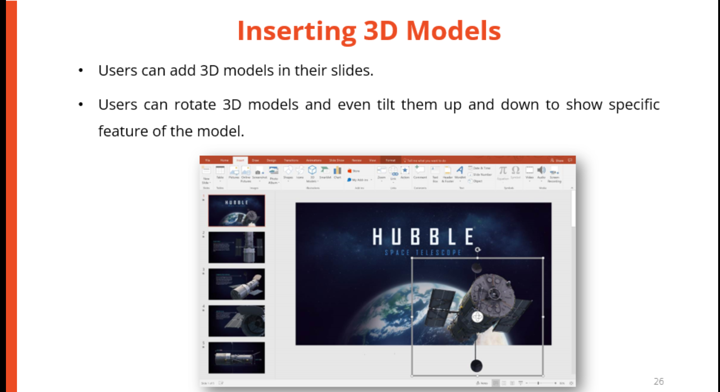
What did I learn ?
Screens & views
Formatting text
Bullets
Shapes,graphics,
icons,3D model

Slide 5
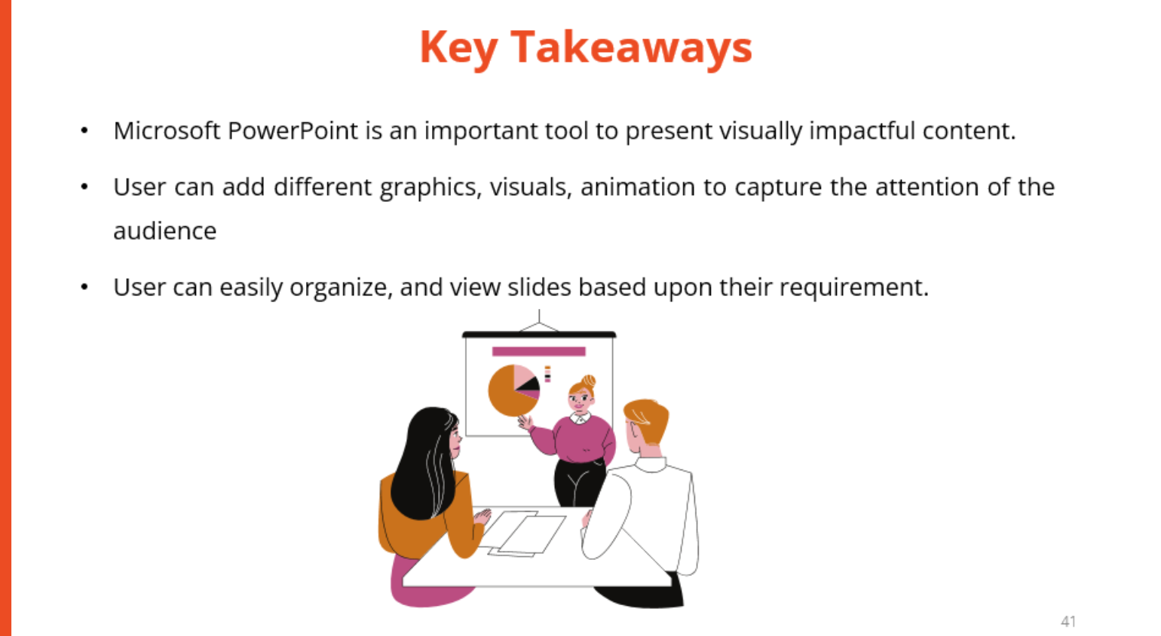
keys

